Slide 1
Computers
By: Awvik
8/29/14

Slide 2
What is a computer?
A computer is an electronic machine that processes information—in other words, an information processor:

Slide 3
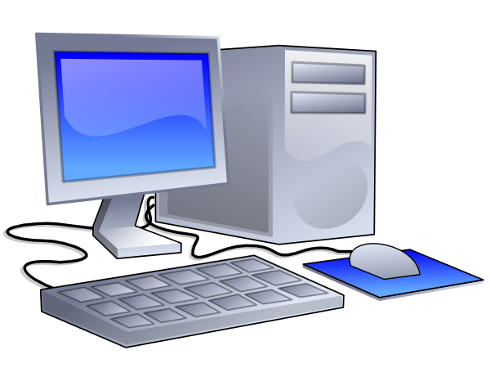
Computers How they Work
A computer takes in raw information (or data) at one end, stores it until it's ready to work on it, chews and crunches it for a bit, then spits out the results at the other end. All these processes have a name. Taking in information is called input, storing information is better known as memory (or storage), chewing information is also known as processing, and spitting out results is called output.

Slide 4
Computers How they Work-continued
The computer does its primary work in a part of the machine we cannot see, a control center that converts data input to information output. This control center, called the central processing unit (CPU), is a highly complex, extensive set of electronic circuitry that executes stored program instructions. All computers, large and small, must have a central processing unit. As Figure 1 shows, the central processing unit consists of two parts: The control unit and the arithmetic/logic unit. Each part has a specific function.

Slide 5
Examples of Jobs using Computers
Cashiers
Web developer
Programmer
Software developer
Database administrator
teachers

Slide 6
Examples of Jobs using Computers - Continued
Health Care
Construction
Architecture
Engineer
Sales
Customer Service

Slide 7
The End

