Slide 1
Overpopulation
By: Awvik Sarkar

Slide 2
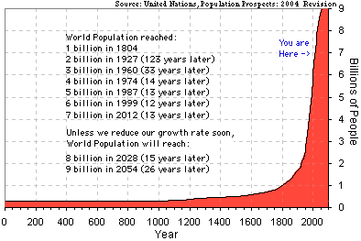
The earth is becoming more and more overpopulated
overtime. The human population is exponentially increasing.

Slide 3
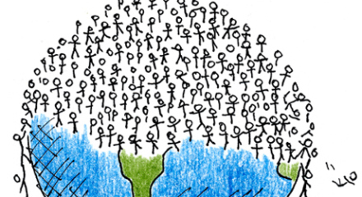
What is overpopulation?
Overpopulation is an undesirable condition where the number of existing human population exceeds the carrying capacity of Earth.

Slide 4
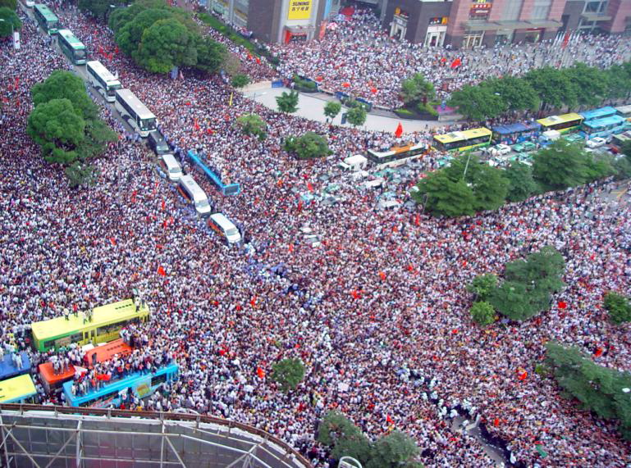
The Earth can only produce a limited amount of water and food, which is falling short of the current needs.

Slide 5
Who is affected?
Humans
Wildlife
Climate
Economy
Food
Oil and Gas

Slide 6
Pros to Overpopulation
Increased Human Resources
Increased Military Might
Higher Demand in Industry

Slide 7
Cons to Overpopulation
Human population has passed the numerical point where all can live in comfort.
The growth of population will soon exceed food production in the future.
Over-population threatens the ecology of the planet through over-use of resources.
The wilderness is unsuitable for humans to live in. So the extra space that is available cannot be used.
Global warming will make the deserts grow, so there will be less inhabitable land.

Slide 8
Solutions to Overpopulation
Better Education
Family Planning
Tax Benefits or Concessions
Knowledge of Sex Education

Slide 9
3 Most populated Countries
China (1,355,692,576)
India (1,236,344,631)
United States (318,892,103)

Slide 10
Technology
Technology with each coming year has affected humanity in many ways. One of these has been the ability to save lives and create better medical treatment for all. A direct result of this has been increased lifespan and the growth of the population. In the past fifty or so years, the growth of population has boomed and has turned into overpopulation.

Slide 11
Bibliography
http://www.internetworldstats.com/stats8.htm
http://www.conserve-energy-future.com/causes-effects-solutions-of-overpopulation.php
http://www.overpopulation.org/
http://www.cosmosmith.com/human_population_crisis.htm

